Slide 1
Section 8.2 Interpreting Bar Graphs and Circle Graphs
© Copyright all rights reserved to Homework depot: www.BCMath.ca

Slide 2
I) Displaying Data with Graphs
Section 1.1 discusses how data can be displayed graphically
  Bar Graphs – comparing categorical values
  Pie charts – compares categories as part of a whole
  Stem plots, Dot plots, and Histograms – illustrates the distribution of values of a quantitative variable
  Time plots – illustrates how values change over time
Help analyze the distribution graphically and look for unusual patterns
© Copyright all rights reserved to Homework depot: www.BCMath.ca

Slide 3
Pie Charts
Show the relationship of the parts to the whole by visually comparing the sizes of each section
The accumulation of all the sectors is 100% (1 whole)
The area of each sector is the percentage frequency
Problem: All the categories must add to a “whole”
© Copyright all rights reserved to Homework depot: www.BCMath.ca

Slide 4
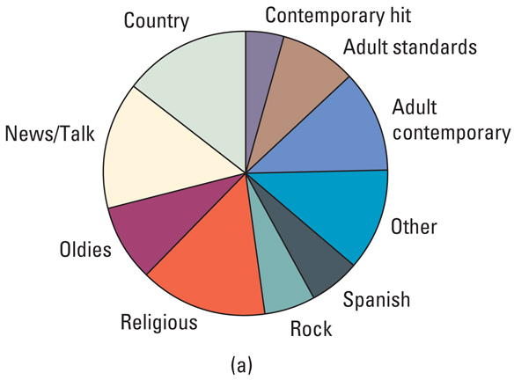
The pie chart below provides information on which music genre is most popular amongst radio listeners from ages 20 to 45. Based on the chart, which statement is true?
The answer is:
Country and Religious music are Played on
the radio more often than Rock and Oldies
b) Spanish Music is more popular than Country
Music
c) Country music is better than Rock
d) Most adult listeners prefer the news than Rock music
e) More than half of adults listeners prefer either Country, Religious or
Adult contemporary music
© Copyright all rights reserved to Homework depot: www.BCMath.ca

Slide 5
Bar Graphs
Compares the frequency of each category
Label the x-axis with the values of the categorical variables
Label the y-axis as frequency (count) or percent
Titled both axis, all bars must have equal width
Ex: Make a Bar Graph with the following information about the number of students from each ethnic background
Number of Students vs Ethnic Backgrounds
Frequency
Korean
Russian
Japanese
American
Spanish
Chinese
Ethnic Groups
© Copyright all rights reserved to Homework depot: www.BCMath.ca

Slide 6
A group of students were asked which subject was their favourite. Use the graph to answer the following questions
Frequency
English
P.E.
Math
Science
Social St.
French
a) How many students were surveyed?
b) What percentage of students prefer Math
c) If the bar for Science disappeared, but you were told the that percentage of
students that chose P.E. was 14%, then how high is the Science bar?
© Copyright all rights reserved to Homework depot: www.BCMath.ca

Slide 7
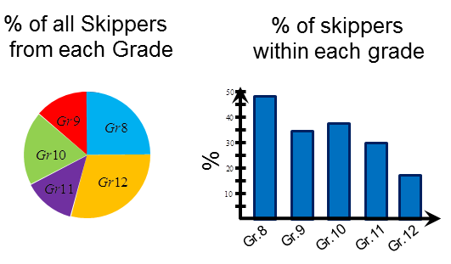
Which Graph is more Useful?
Note: Pie Charts is only used when comparing categories to the “whole”
Ex: The principal wants to create a program to counter attack unexcused absences in school. According to the graphs provided, which grade level should he/she focus on?
The information provided by the bar graph can not be made with a pie chart
Majority of all students skipping are in grade 12, but only a small percentage skip
A large percentage of 8’s are missing class. Therefore, focus on the 8’s.
© Copyright all rights reserved to Homework depot: www.BCMath.ca

Slide 8
Stem and Leaf Plot
Shows the distribution for Quantitative variables
Includes actual numerical values in the graph
Useful for comparing data sets back to back
The last (rightmost) digit becomes the leaf, and is plotted to the right of the vertical bar
The left digits become the stem, which are plotted to the left of the vertical bar
The stems and leaf are listed in order
If there are too many values, remove last digit and make all values in terms of 10 OR
Split the stems: 1st half and 2nd half
© Copyright all rights reserved to Homework depot: www.BCMath.ca

Slide 9
How to Make a Stemplot
Ex: The following data indicate the age of the audience in a workshop. Draw a stem-leaf plot for the data:
Take the tens digit
to form the stem
The “ONES” digit
is used to fill in the
plot
The smaller digit
on the left and the
bigger on the right
© Copyright all rights reserved to Homework depot: www.BCMath.ca

